Slide 1
Random Variables and their Probability Distributions
Programming and Data Analysis for Modern Neuroscience
Spring 2021

Slide 2
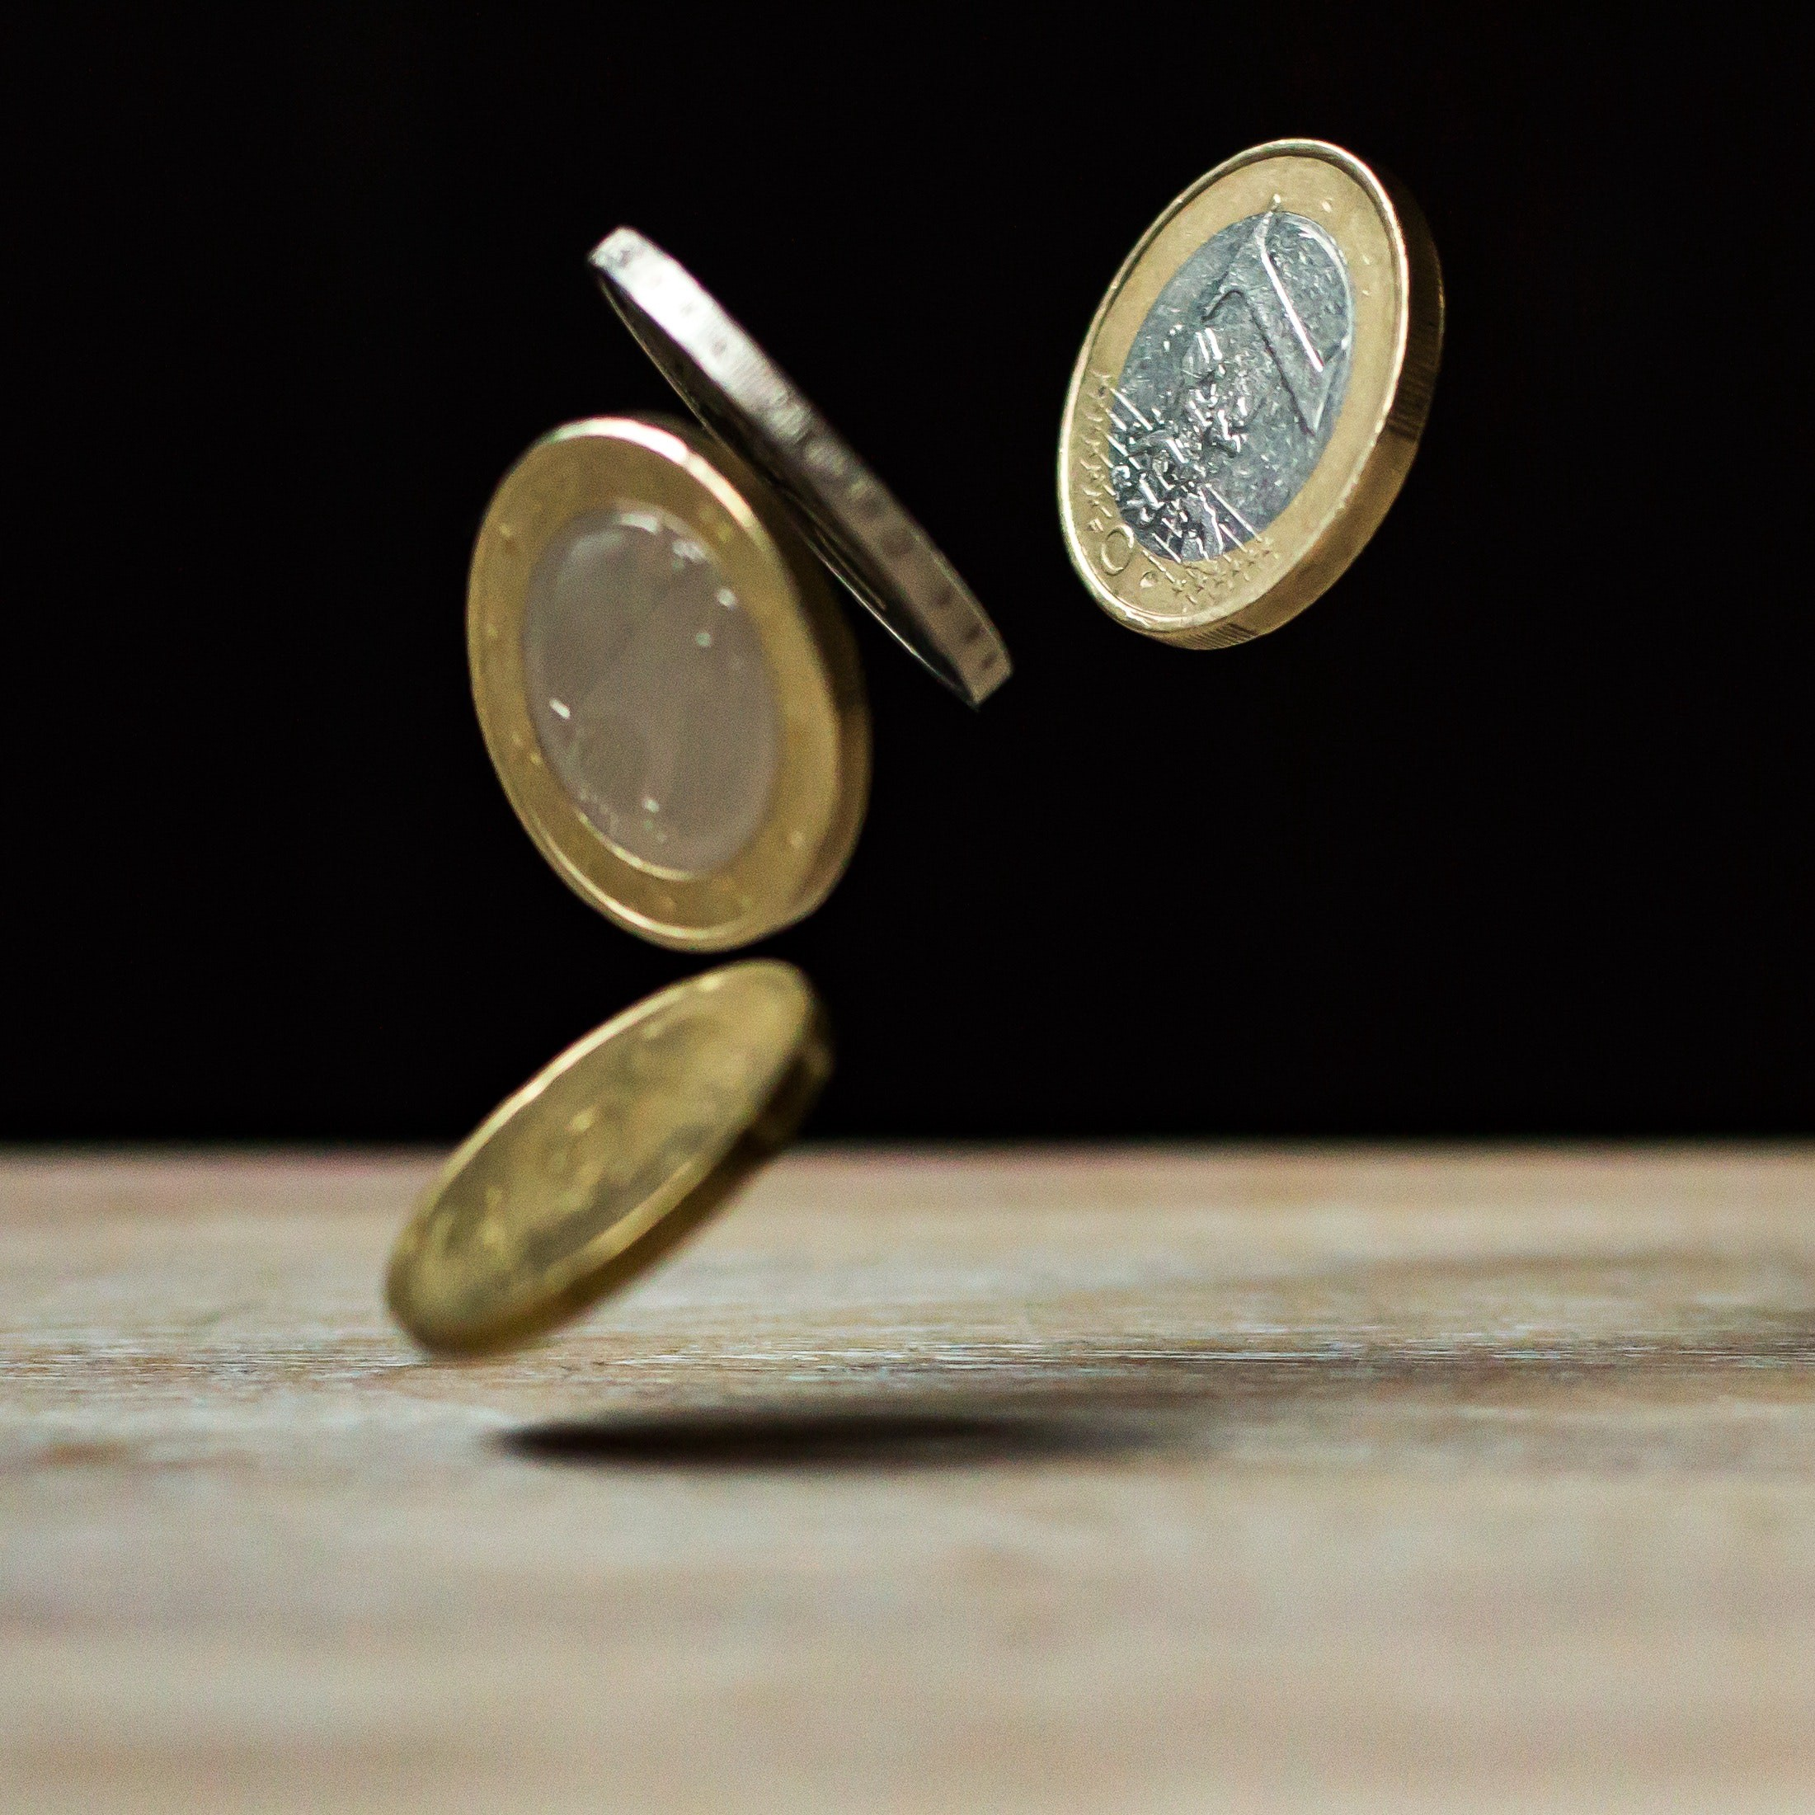
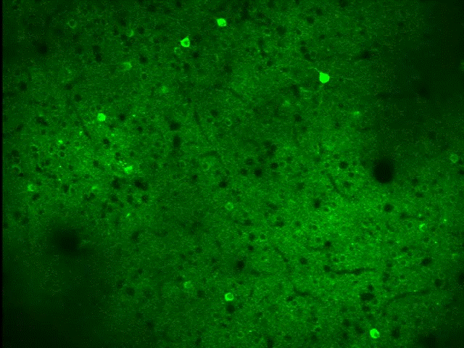
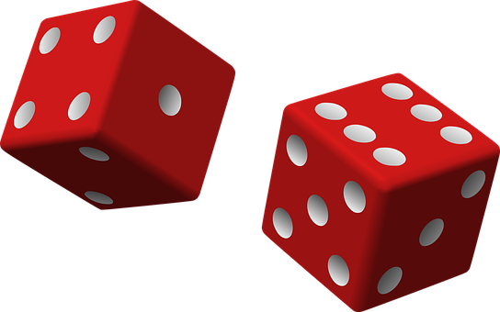
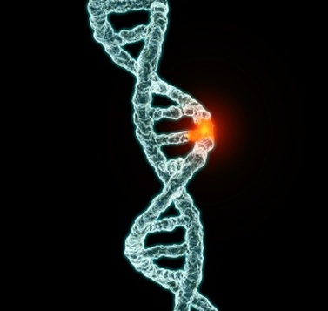

Random Variables
Notes:
Without programs that can harness the computational power of modern computers understanding large and complex datasets that describe the behavior of neural systems is practically inconceivable.

Slide 3
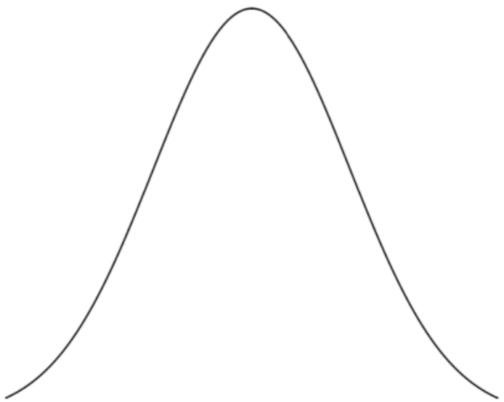
Discrete & Continuous Random Variables
Discrete
Continuous
Probability Density
Function (pdf)
Probability
X = Tomorrow’s
Temperature
X = Tomorrow’s Weather

Slide 4
Discrete & Continuous Random Variables
Discrete
Continuous
Probability Density
Function (pdf)
Probability
e.g. Counting:
How many cells/spikes?
e.g. Classification:
Which cell type?
e.g. Measurement:
Membrane Voltage,
Synapse Volume,
Ca²⁺ Concentration, etc.

Slide 5
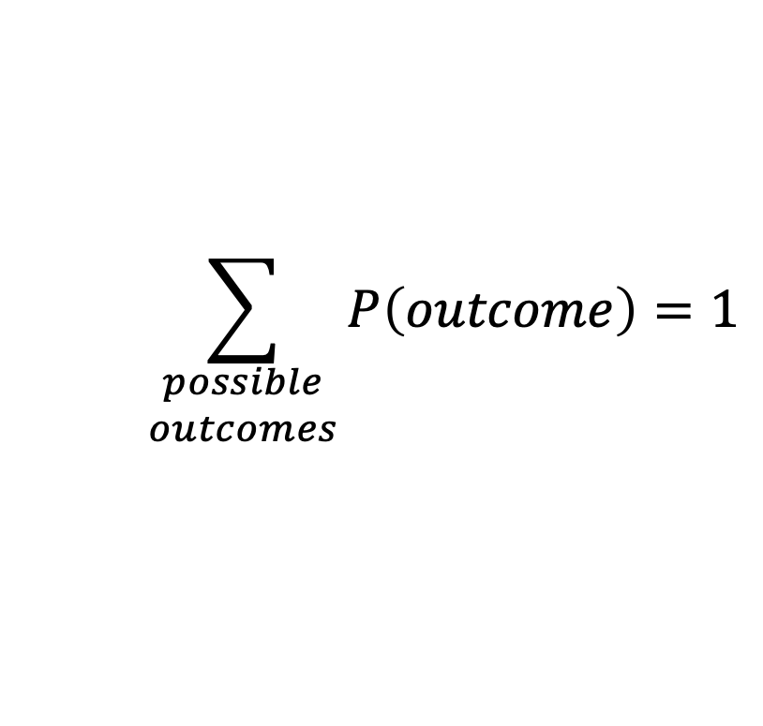
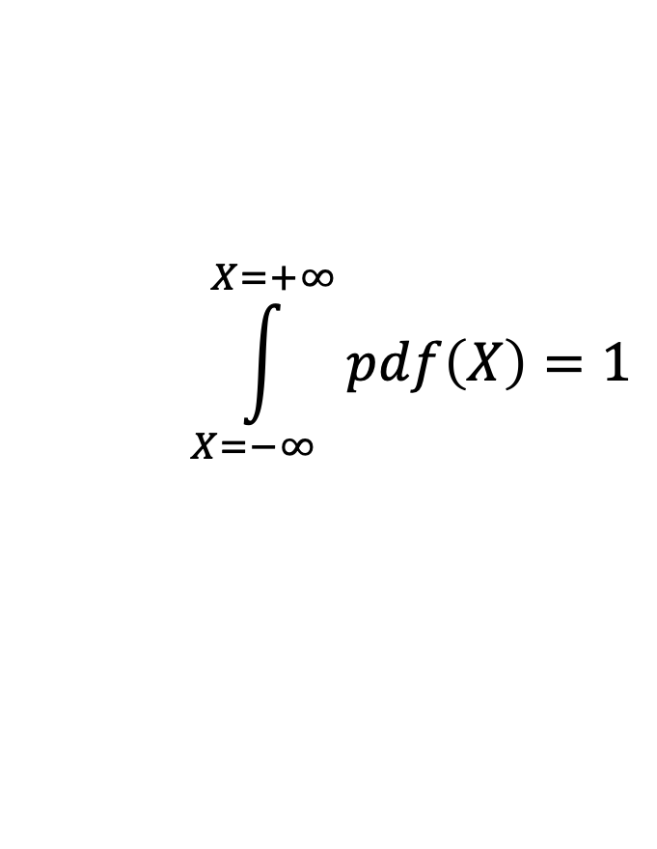
Sum of all possible probabilities = 1
Discrete
Continuous
Probability Density
Function (pdf)
Probability
X→
A
B
C
D
X
$$\sum_{\begin{matrix}possible \\ outcomes\end{matrix}}{P\left(outcome\right)}=1$$
$$\int_{X=−∞}^{X=+∞}{pdf\left(X\right)}=1$$

Slide 6
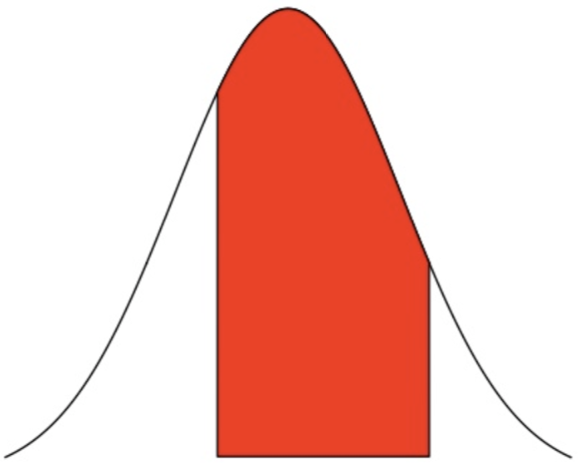
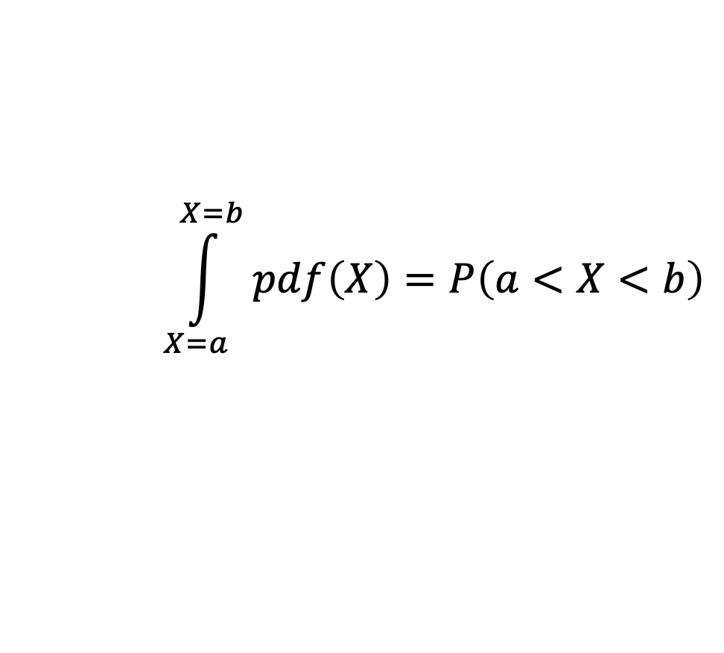
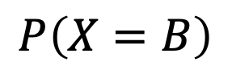
Probability vs. Probability Density
Discrete
Continuous
Probability Density
Function (pdf)
Probability
X→
A
B
C
D
X=a
X=b
$$\int_{X=a}^{X=b}{pdf\left(X\right)}=P\left(a<X<b\right)$$
$$P\left(X=B\right)$$

Slide 7
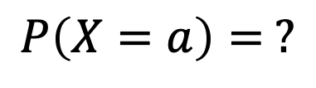
Probability vs. Probability Density
Discrete
Continuous
Probability Density
Function (pdf)
Probability
X→
A
B
C
D
X=a
$$P\left(X=B\right)$$
$$P\left(X=a\right)= ?$$

Slide 8
Probability vs. Probability Density
Discrete
Continuous
Probability Density
Function (pdf)
Probability
X→
A
B
C
D
X=a
$$P\left(X=B\right)$$
$$P\left(X=a\right)= ?$$
NOT a probability!!!

Slide 9
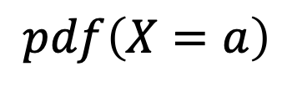
Probability vs. Probability Density
Discrete
$$pdf\left(X=a\right)$$
Probability Density
Function (pdf)
Probability
X→
A
B
C
D
X=a
$$P\left(X=B\right)$$
$$P\left(X=a\right)= ?$$
NOT a probability!!!

Slide 10
Probability Mass = Probability
Discrete
Continuous
Probability Mass
Function (pmf)
Probability Density
Function (pdf)
X→
A
B
C
D
X
PMF = Probability Mass Function ← Discrete
PDF = Probability Density Function ← Continuous

Slide 11
Cumulative Density Function (CDF)
area
Probability that tomorrow’s temperature is < 1 ℃?

Slide 12
Survival Function
SF(x=1)
area
CDF(x=1)
Probability that tomorrow’s temperature is > 1 ℃?

Slide 13
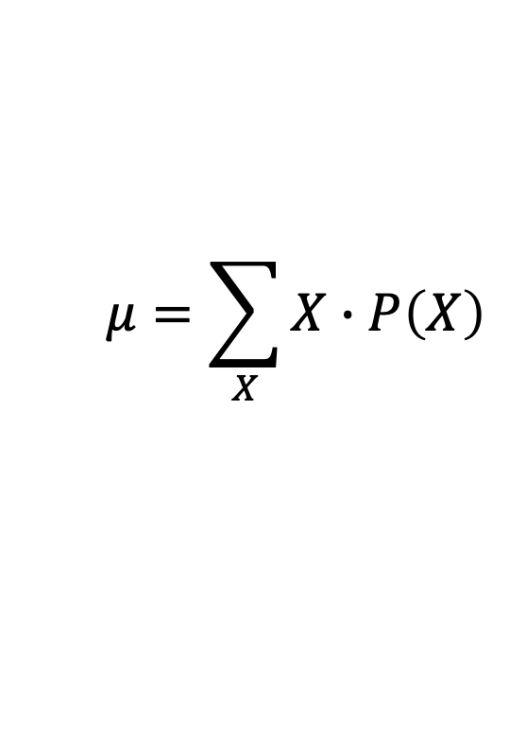
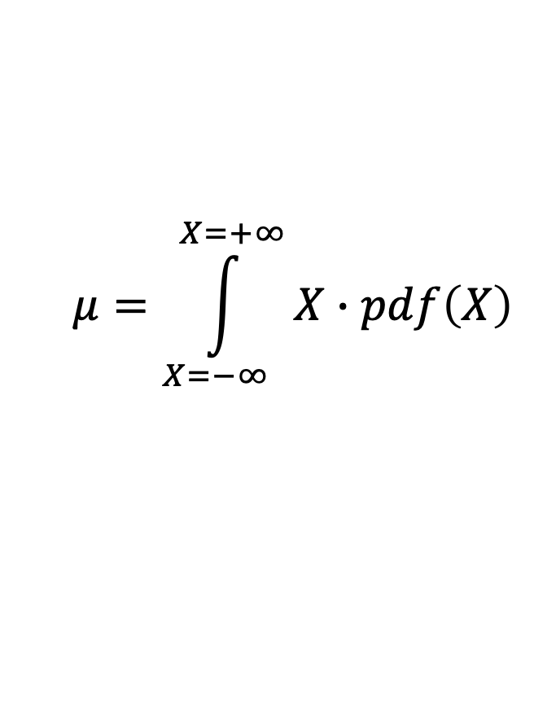
Statistic: Mean
Discrete
Continuous
Probability Density
Function (pdf)
Probability
X→
A
B
C
D
X
$$μ=\int_{X=−∞}^{X=+∞}{X∙pdf\left(X\right)}$$
$$μ=\sum_{X}{X∙P\left(X\right)}$$

Slide 14

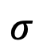
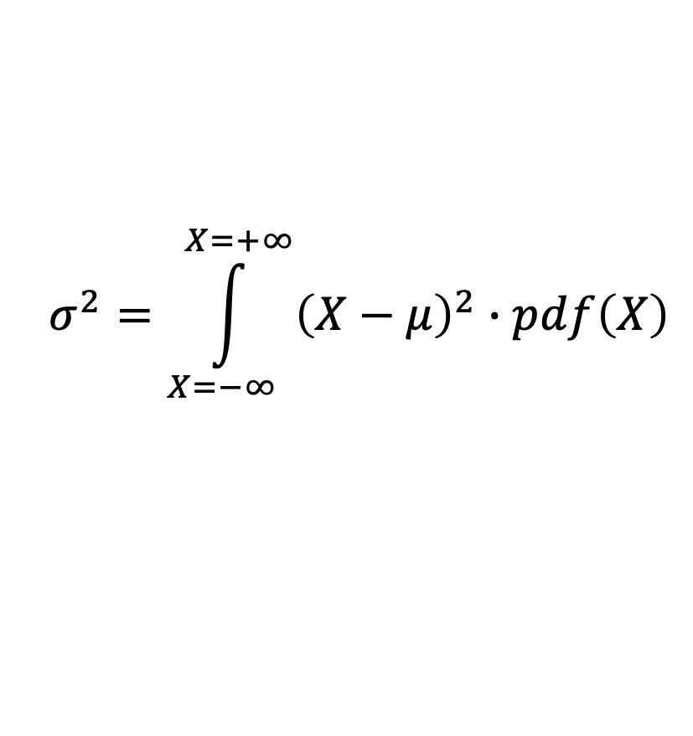
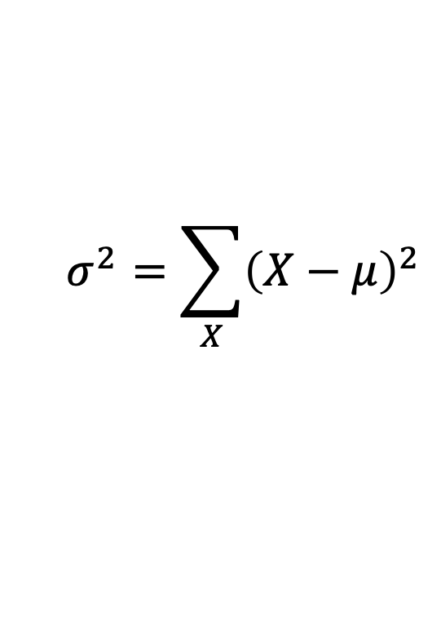
Statistic: Variance ($σ^{2}$) about Mean
Discrete
Continuous
$$σ$$
Probability Density
Function (pdf)
$$σ$$
Probability
X→
A
B
C
D
X
$$σ^{2}=\int_{X=−∞}^{X=+∞}{{\left(X−μ\right)}^{2}∙pdf\left(X\right)}$$
$$σ^{2}=\sum_{X}{{\left(X−μ\right)}^{2}}$$

Slide 15
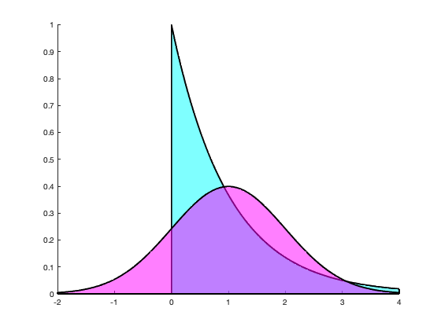
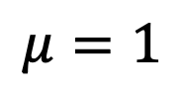
Shape of a Distribution
$$μ=1$$

Slide 16
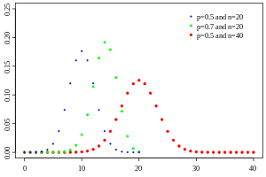
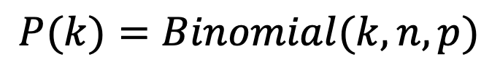
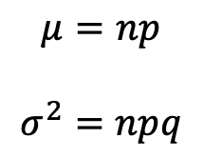
Binomial Distribution
Probability for k successes out of n identical and independent trials each with a probability of success p.
$$P(k)=Binomial(k,n,p)$$
$$μ=np$$
$$σ^{2}=npq$$

Slide 17
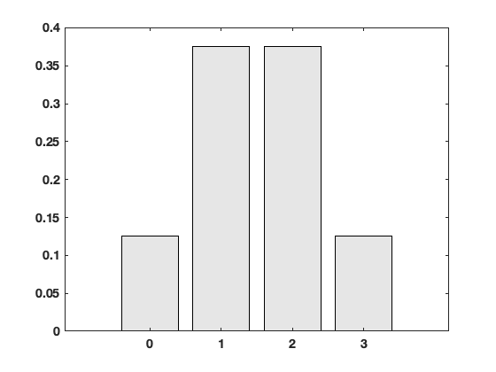
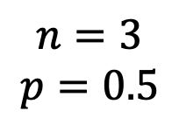
Binomial Distribution
Fair coin: probability of 2 out of 3 heads?
1st toss
2nd toss
3rd toss
$$n=3$$
$$p=0.5$$
Probability
# of heads

Slide 18
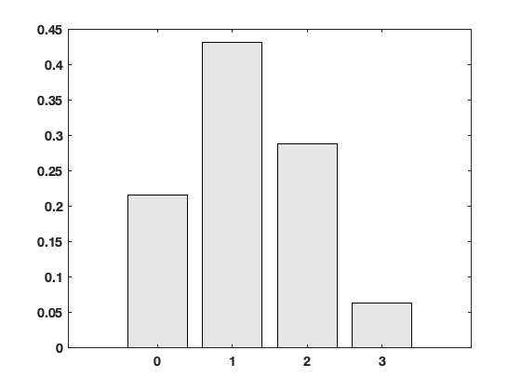
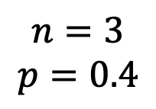
Binomial Distribution
Biased coin (40% heads): probability of 2 out of 3 heads?
1st toss
2nd toss
3rd toss
$$n=3$$
$$p=0.4$$
Probability
# of heads

Slide 19
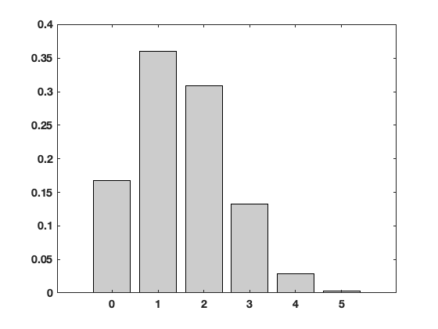
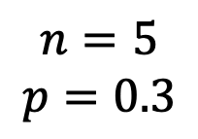
Binomial Distribution
Presynaptic stimulation elicits release of a synaptic vesicle with neurotransmitter with a 30% probability. How many vesicles are expected to be released across five separate stimulations.
$$n=5$$
$$p=0.3$$
Probability
# of vesicles released

Slide 20
Binomial Distribution
Presynaptic stimulation elicits release of a synaptic vesicle with neurotransmitter with a 30% probability. How many vesicles are expected to be released across five separate stimulations.
$$n=5$$
$$p=0.3$$
Remember the Assumptions!!!
What if stimulations came in a high frequency train?
Probability
# of vesicles released

Slide 21
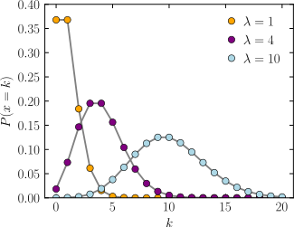
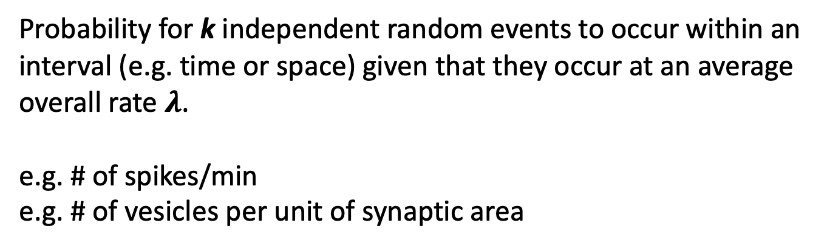
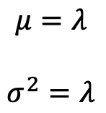
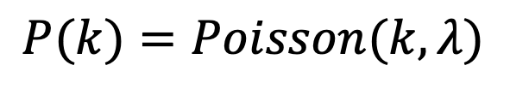
Poisson Distribution
Probability for k independent random events to occur within an interval (e.g. time or space) given that they occur at an average overall rate $λ$.
e.g. # of spikes/min
e.g. # of vesicles per unit of synaptic area
$$P(k)=Poisson(k,λ)$$
$$μ=λ$$
$$σ^{2}=λ$$

Slide 22
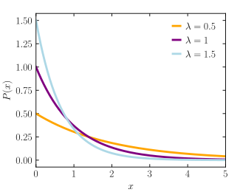
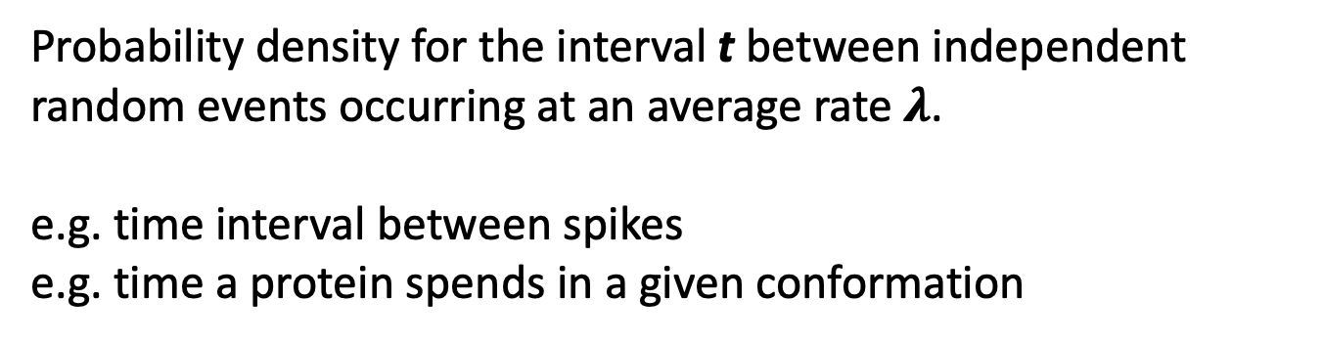
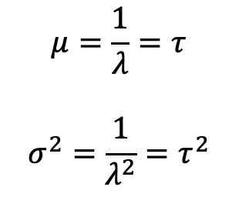
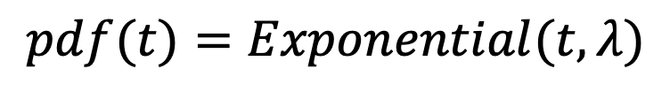
Exponential Distribution
Probability density for the interval t between independent random events occurring at an average rate $λ$.
e.g. time interval between spikes
e.g. time a protein spends in a given conformation
$$pdf(t)=Exponential(t,λ)$$
$$μ=\frac{1}{λ}=τ$$
$$σ^{2}=\frac{1}{λ^{2}}=τ^{2}$$

Slide 23
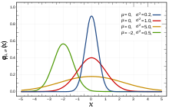
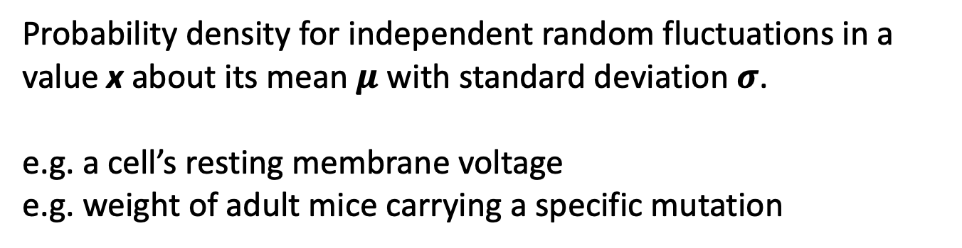
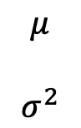
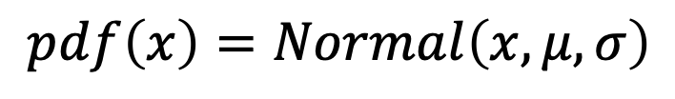
Normal Distribution
Probability density for independent random fluctuations in a value x about its mean $μ$ with standard deviation $σ$.
e.g. a cell’s resting membrane voltage
e.g. weight of adult mice carrying a specific mutation
$$pdf\left(x\right)=Normal\left(x,μ,σ\right)$$
$$μ$$
$$σ^{2}$$

Slide 24
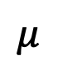
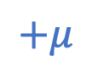
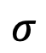
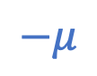
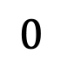
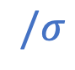
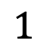


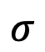
Standard Normal Distribution (μ=0, σ=1)
$$∗σ$$
$$+μ$$
$$1$$
$$σ$$
$$σ$$
$$/σ$$
$$−μ$$
$$0$$
$$0$$
$$μ$$

